Slide 1

2019 ANNUAL TENANT MEETING

Slide 2

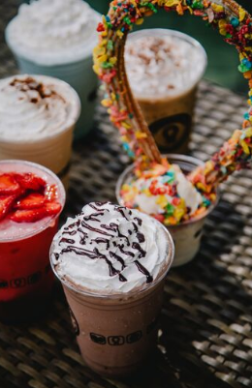


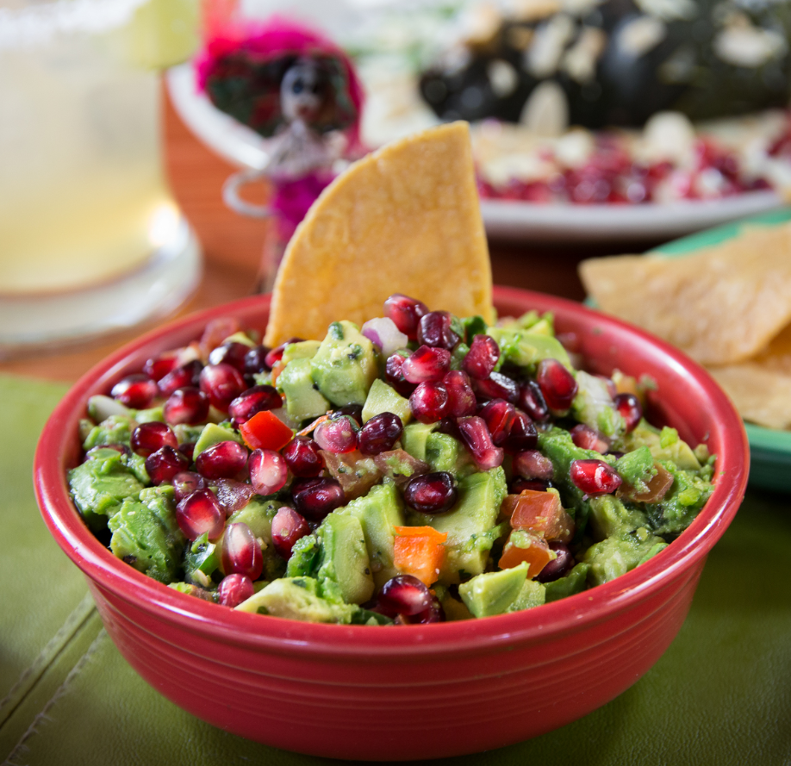


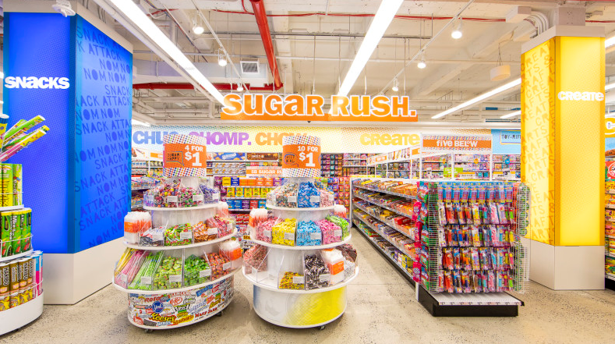
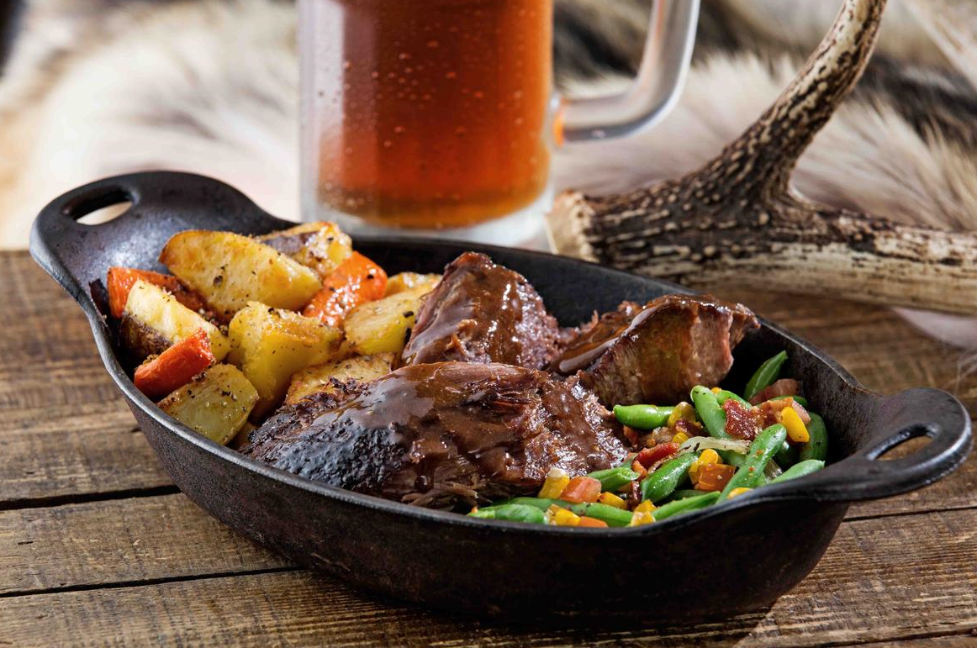
NEW + COMING SOON STORES
New
Barrio Queen
TaylorMade Phades
Coming Soon
Barrio Queen
Fox in a Box
TaylorMade Phades
Twin Peaks
Pop Up
Creations

Slide 3


Slide 4
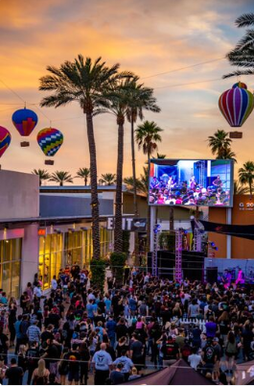
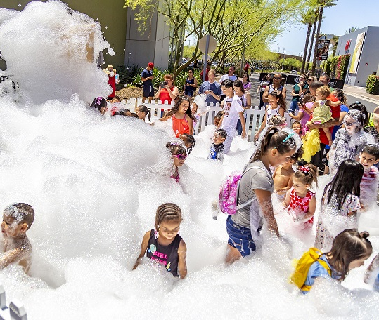
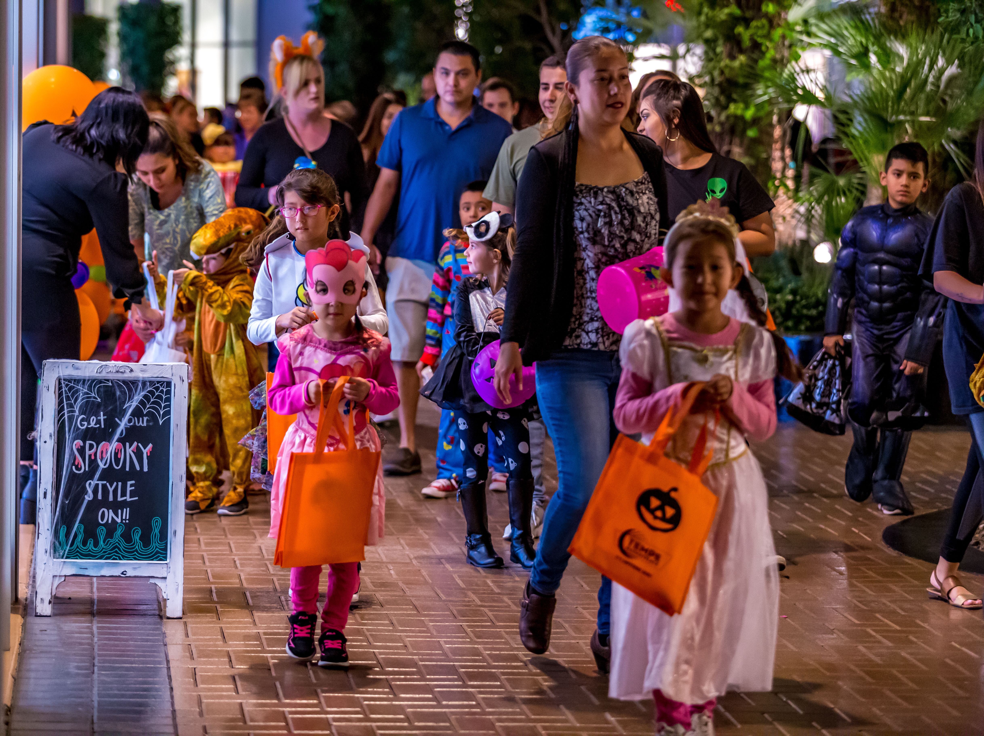
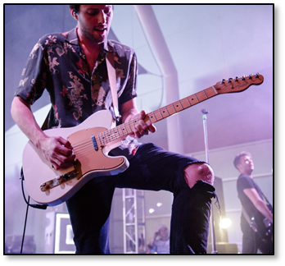
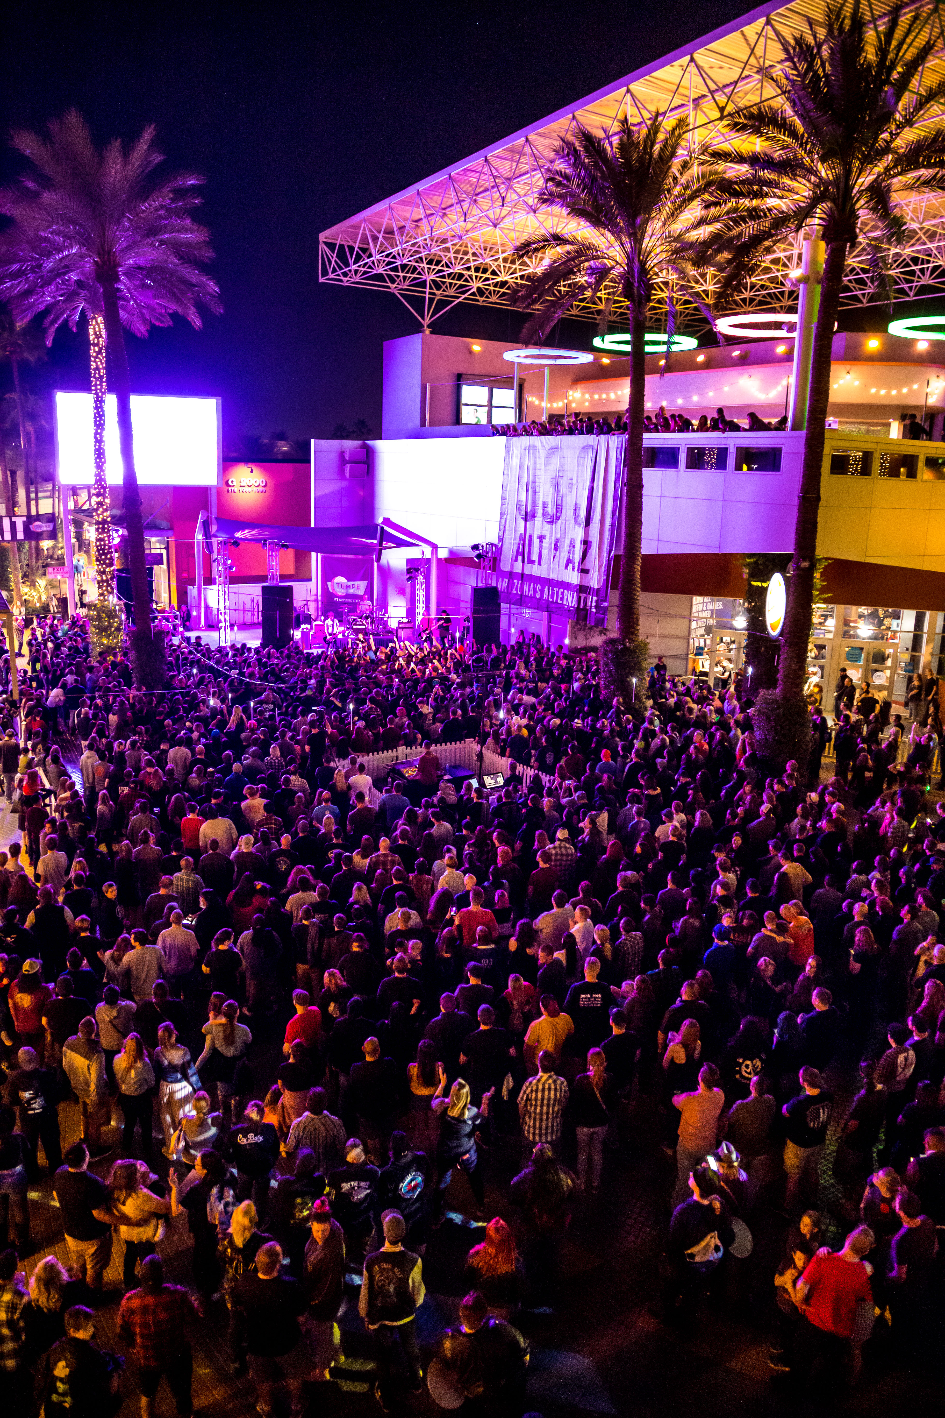
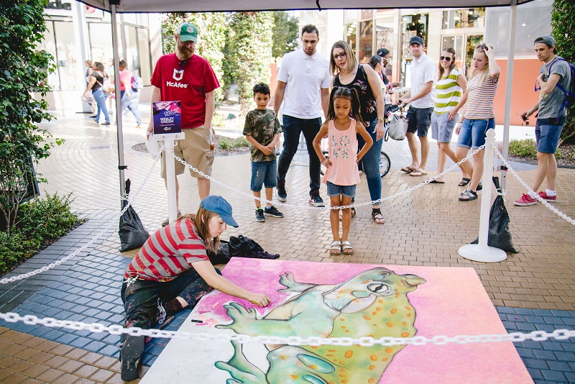
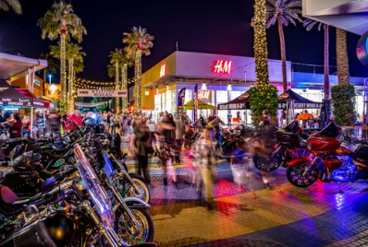

Event highlights
432 EVENTS YTD IN 2019, INCLUDING COMMUNITY PERFORMANCES
  Stroller Strides – hundreds of people (4x a week)
  Road Runner Runs – 50+ per run (every Thursday)
  Summer Splash – 650+ people per event (7 evenings)
  ROCK IT UP Concerts – 1,500 people each show (6 shows)
  The Damned Things Concert – 600+ people
  Katastro Tropical Heartbreak Festival Concert – 800+ people
  Chalk Walk – 3,500 people
  Creepy Candy Crawl – 4,500 people
  Bike Night – 500 people per event (10 evenings)
  Bubble Bash – 5,000+ people
  Spring Training Trolley – 5,614 people (18 home games)
  Street Safari – 1,000 people
  Up, Up & Away – 1,000 people
  Umbrella Pop – 1,000 people
  Friday and Saturday Free Live Music – hundreds of people (every weekend)
53,564 TOTAL ATTENDEES FOR MAJOR EVENTS

Slide 5
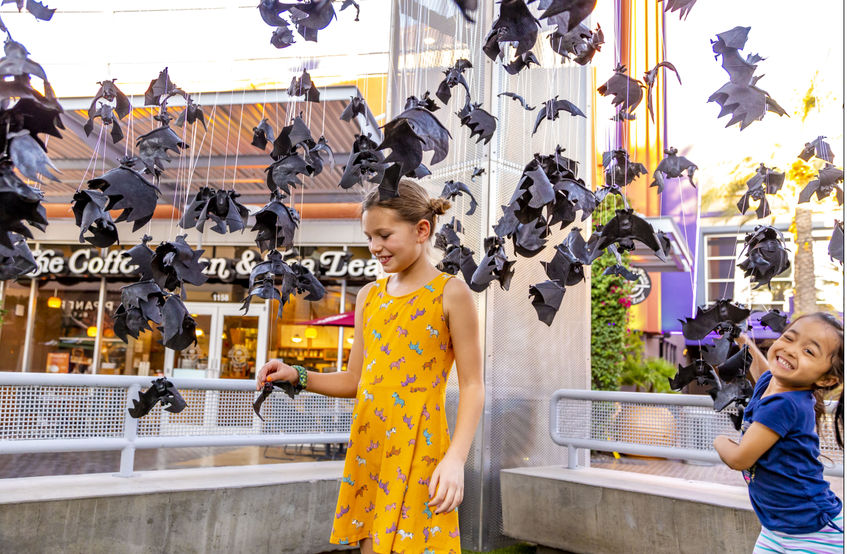
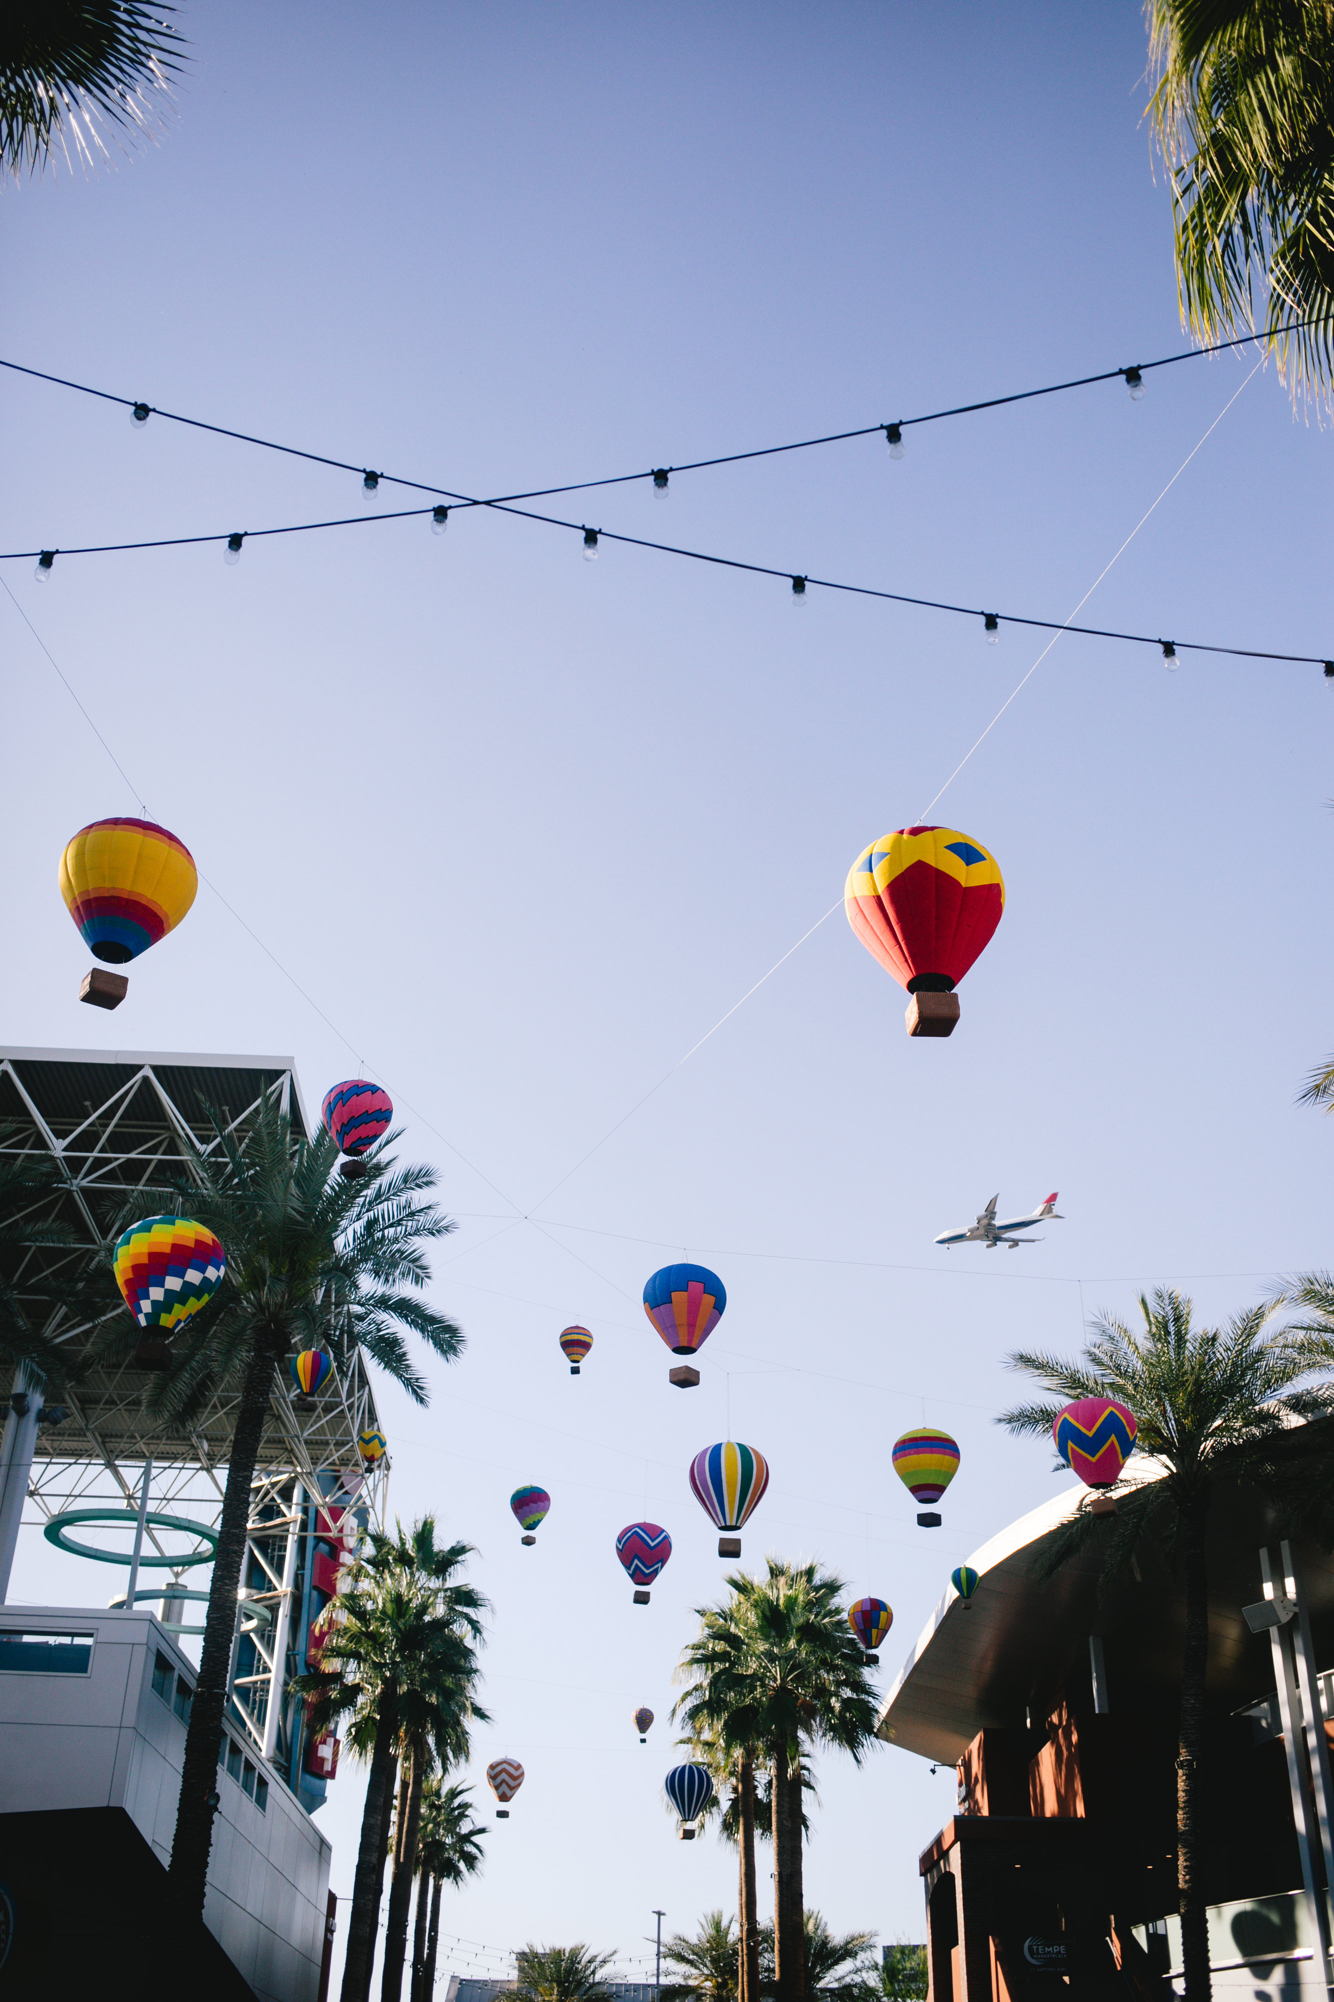
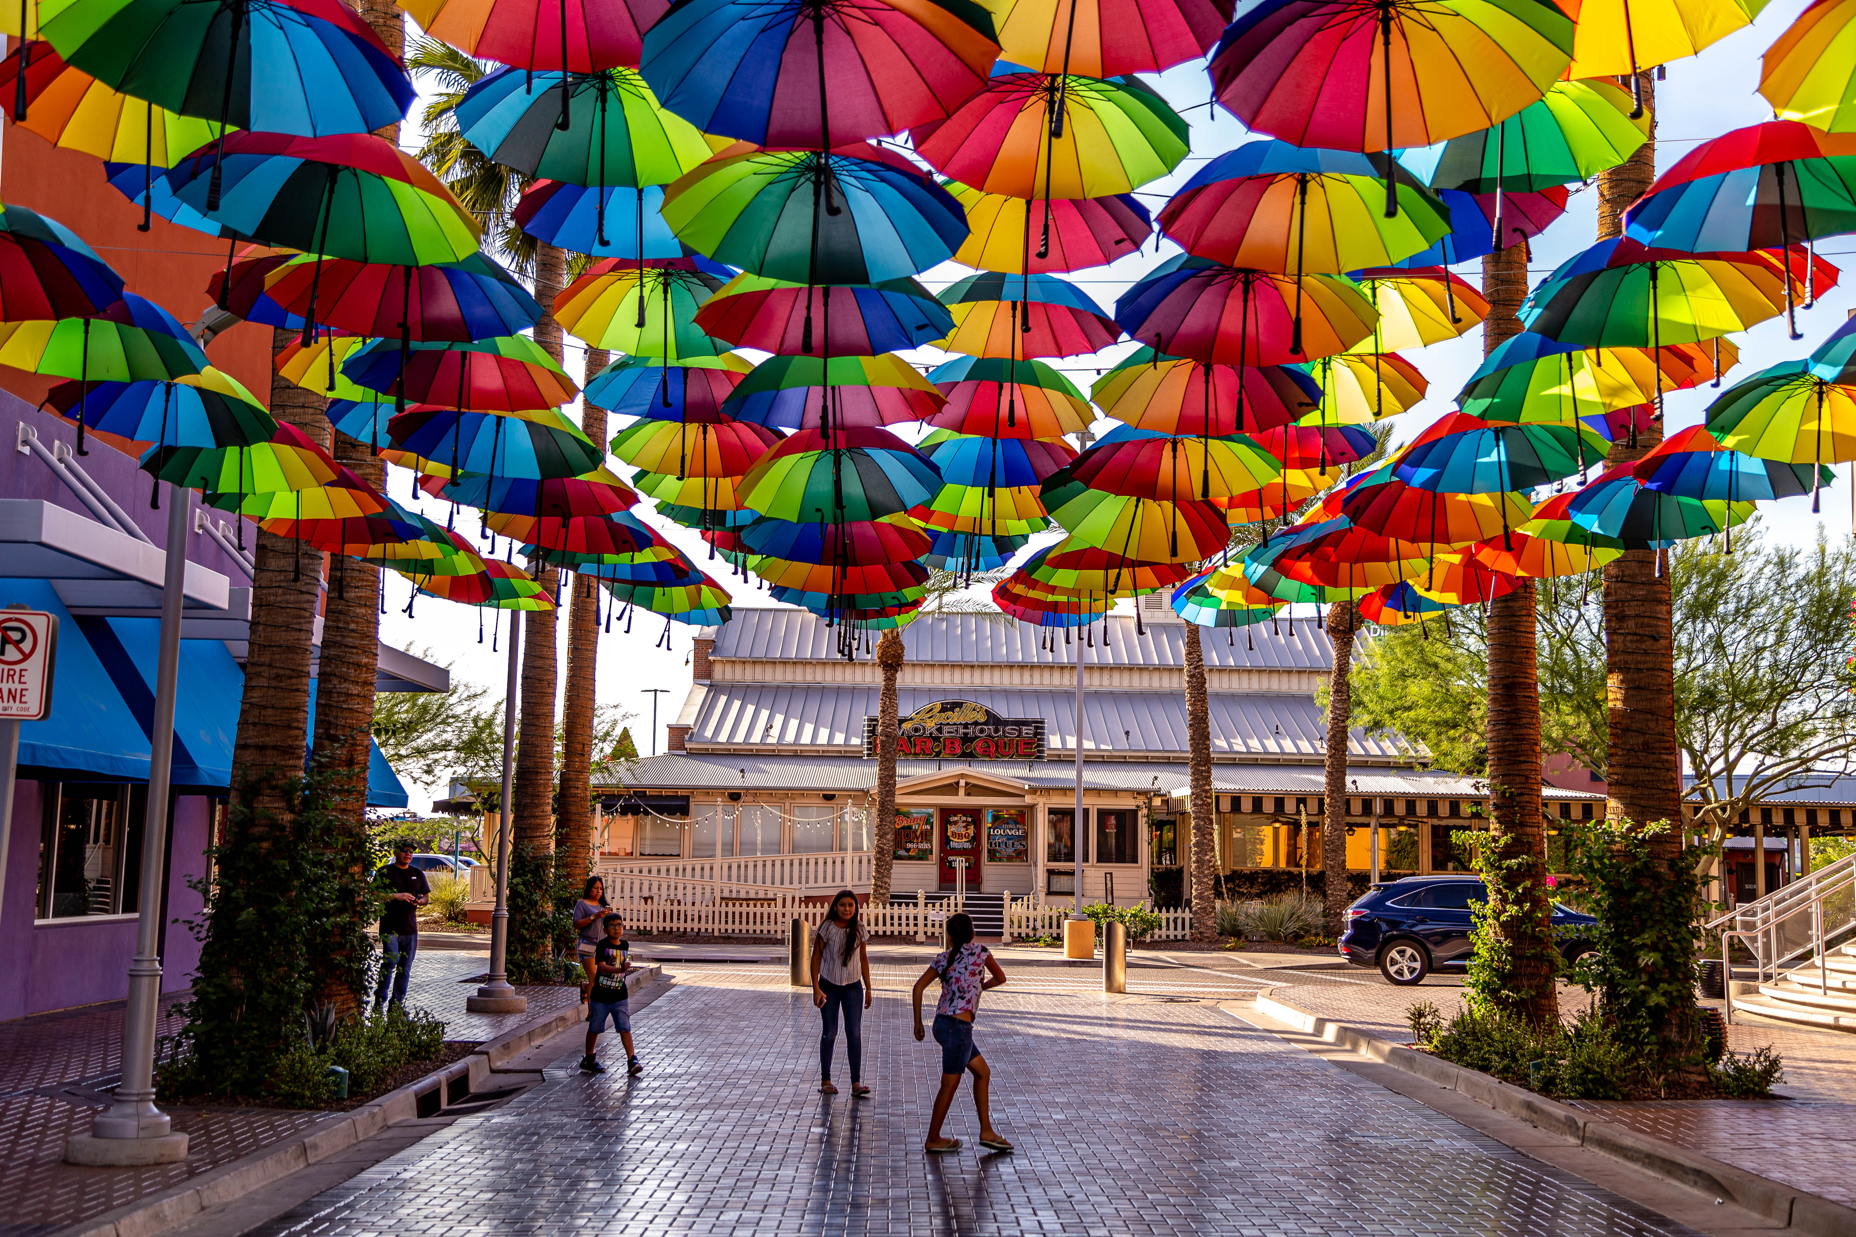
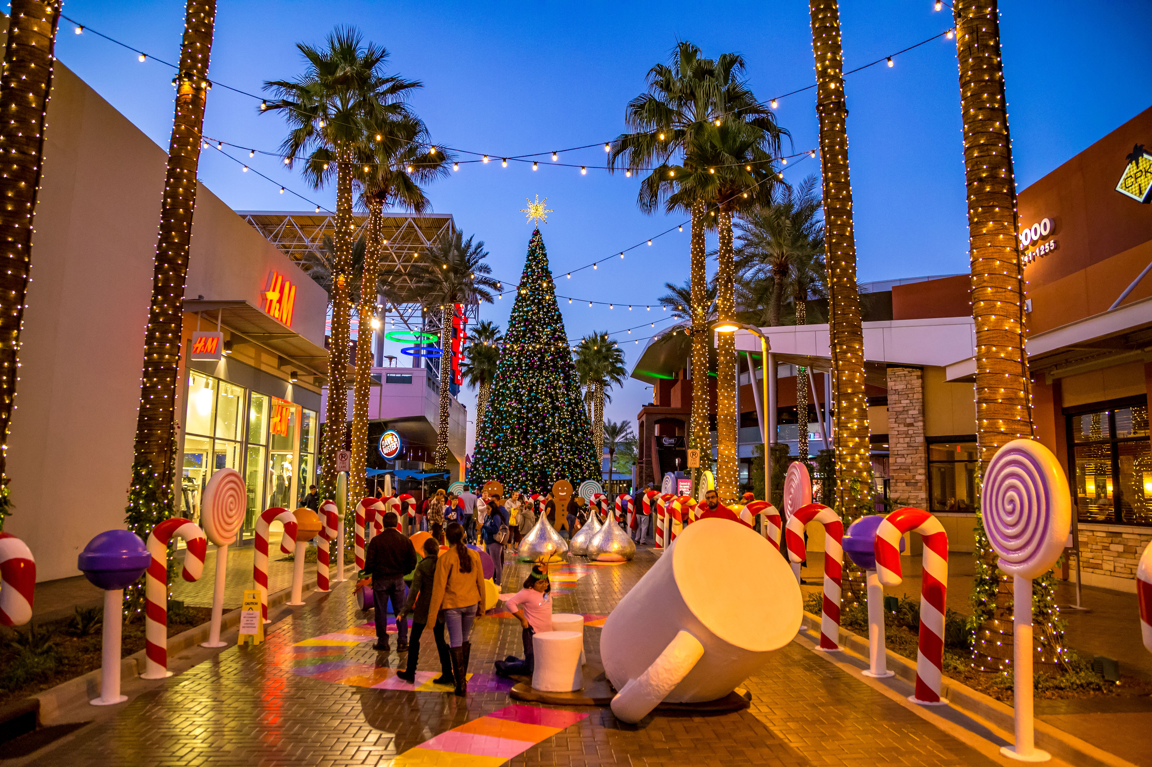
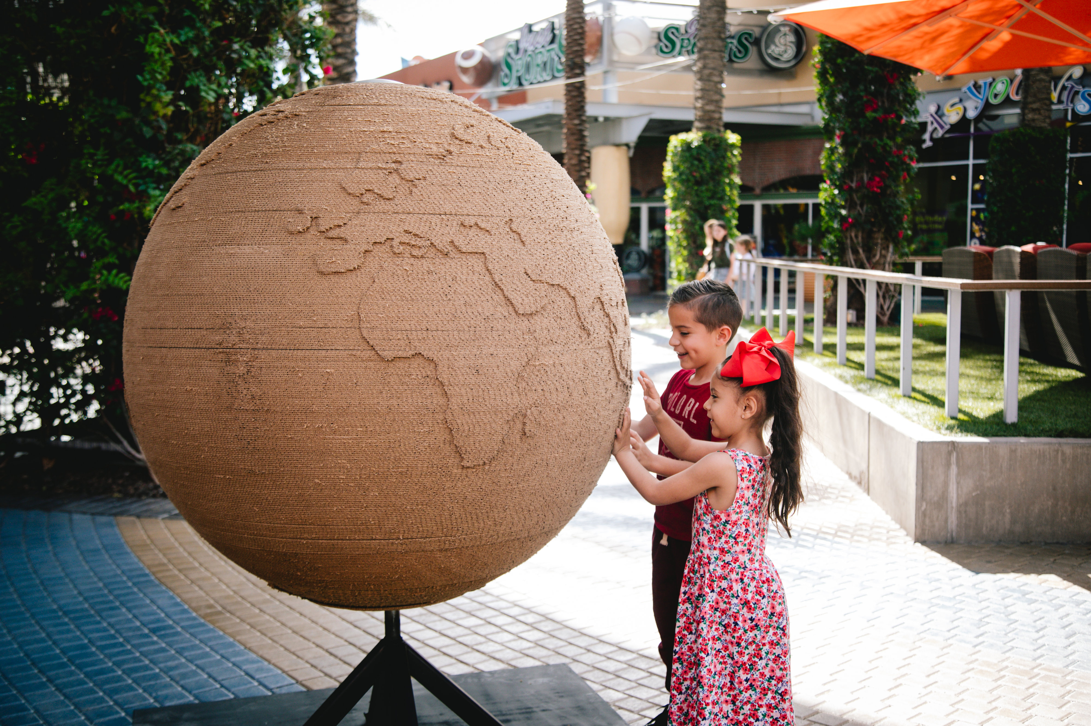
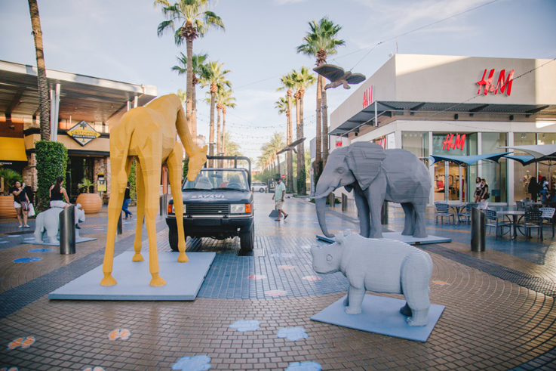
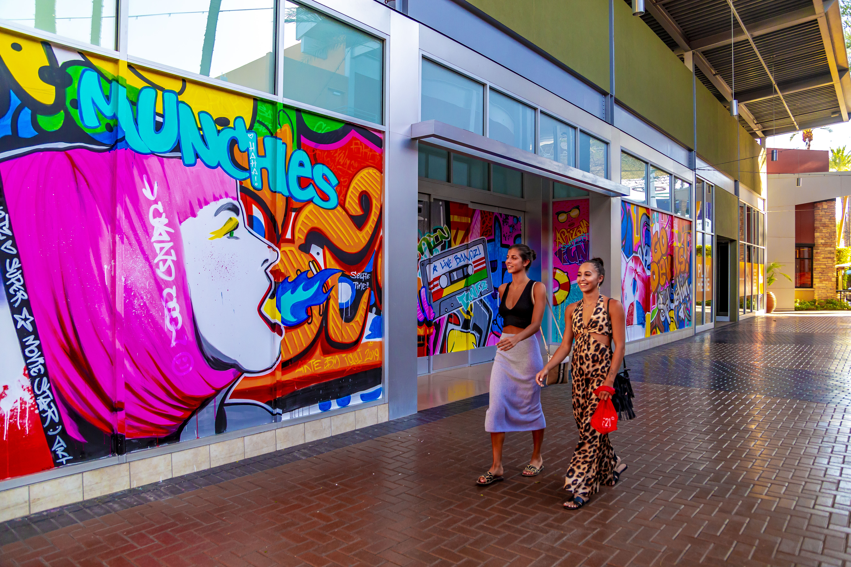

ART INSTALLATIONS
NEW ART INSTALLATIONS
  Up, Up & Away
  Earth Day Globe
  Street Art Mural
  Umbrella Pop
  Street Safari
  Oh, Bats
  Candy Cane Lane

Slide 6
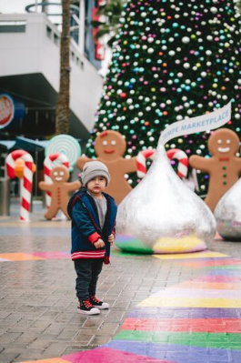
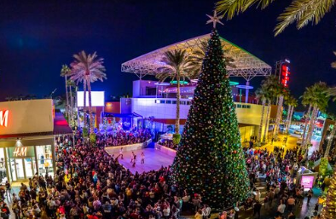
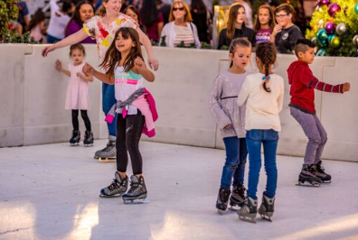
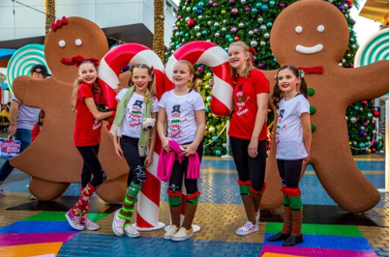
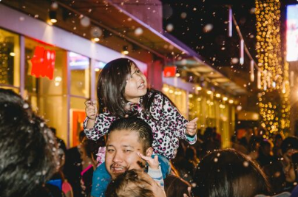
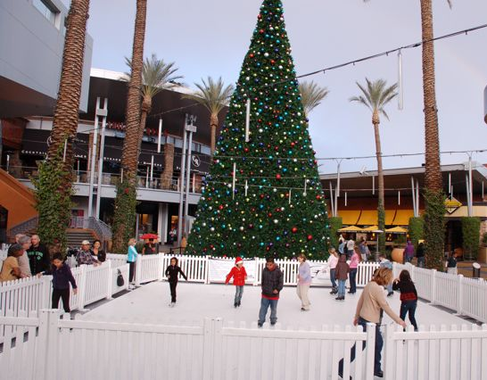
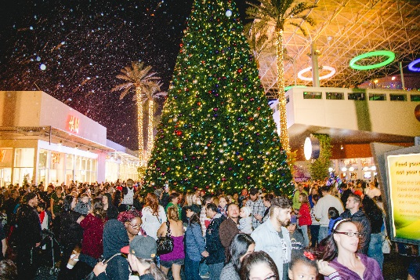
Holiday events
Holiday Tree Lighting + First Snowfall
Nightly Snowfall
Holiday Skating
Candy Cane Lane
Salvation Army Angel Tree

Slide 7


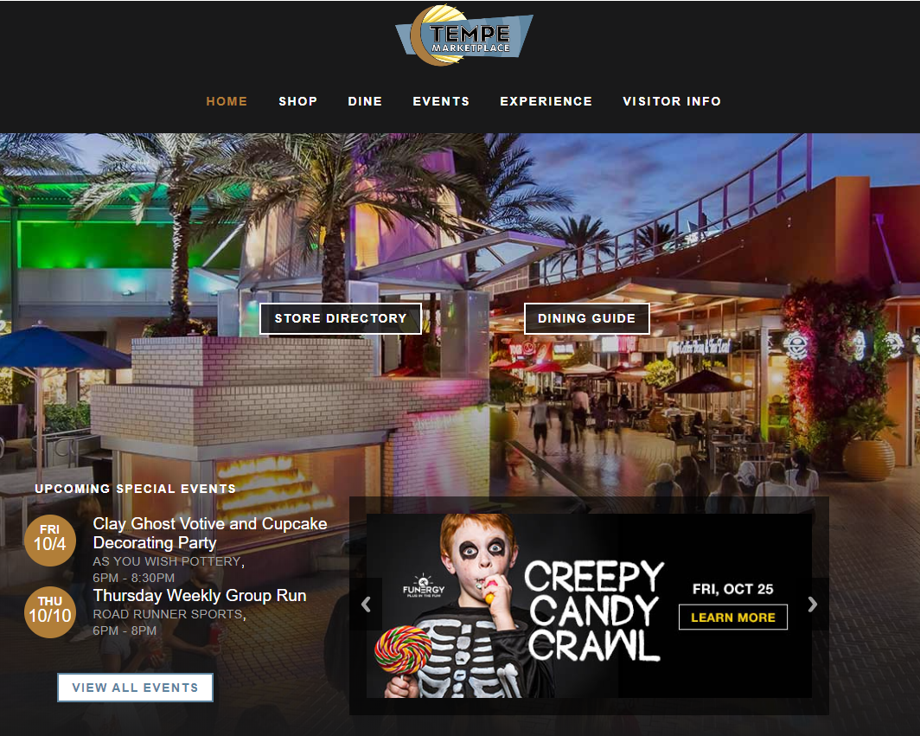
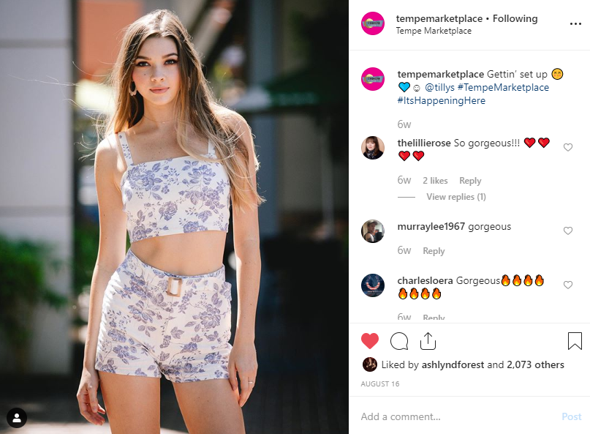

Digital marketing
DIGITAL ADS
  Display – 2,012,199 YTD impressions
  Social – 700,106 YTD impressions
WEBSITE TRAFFIC
  94,980+ hits per month
SOCIAL MEDIA
  Facebook
    Monthly average impressions: 684,085+
    49,854+ likes
  Instagram
    Monthly average impressions: 306,534+
    14,550+ followers
EMAIL BLASTS
  Database: 28,576 recipients
    11% average open rate

Slide 8

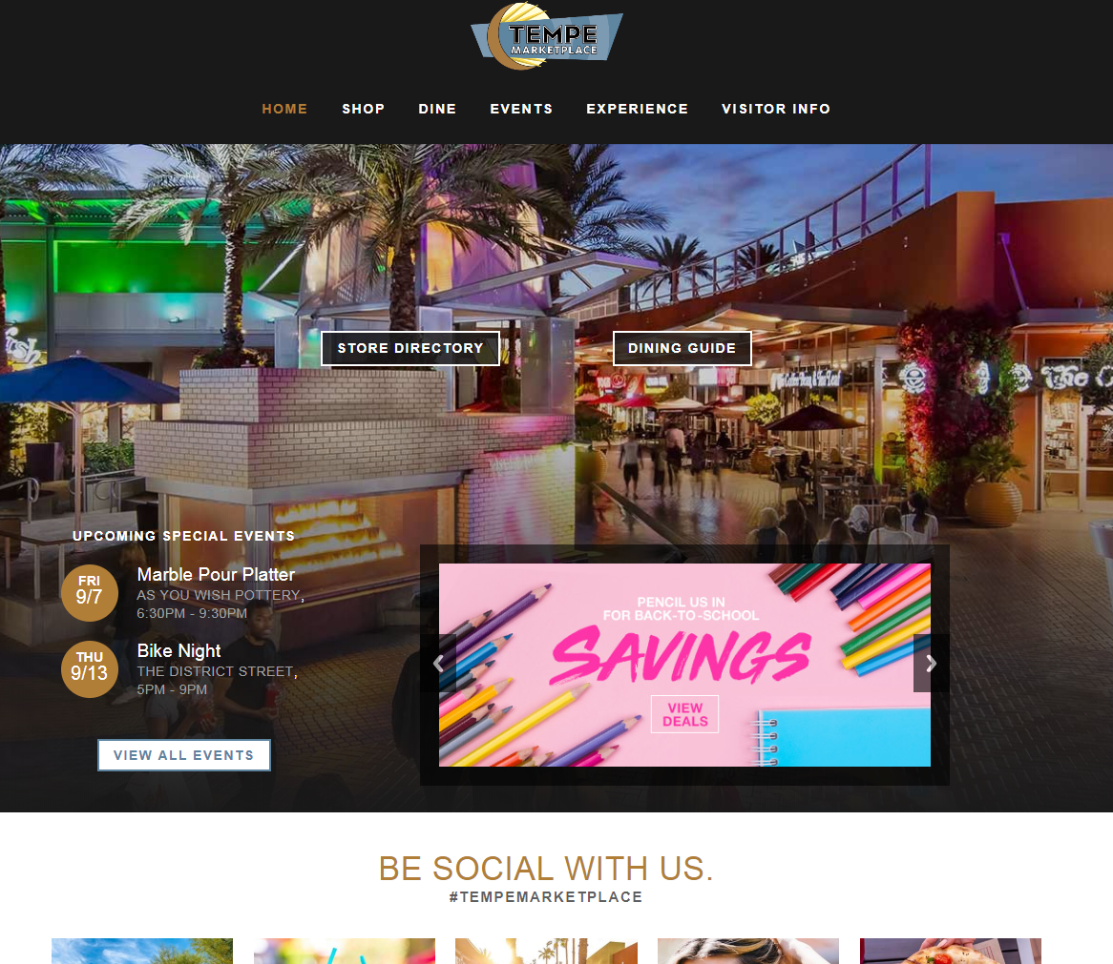
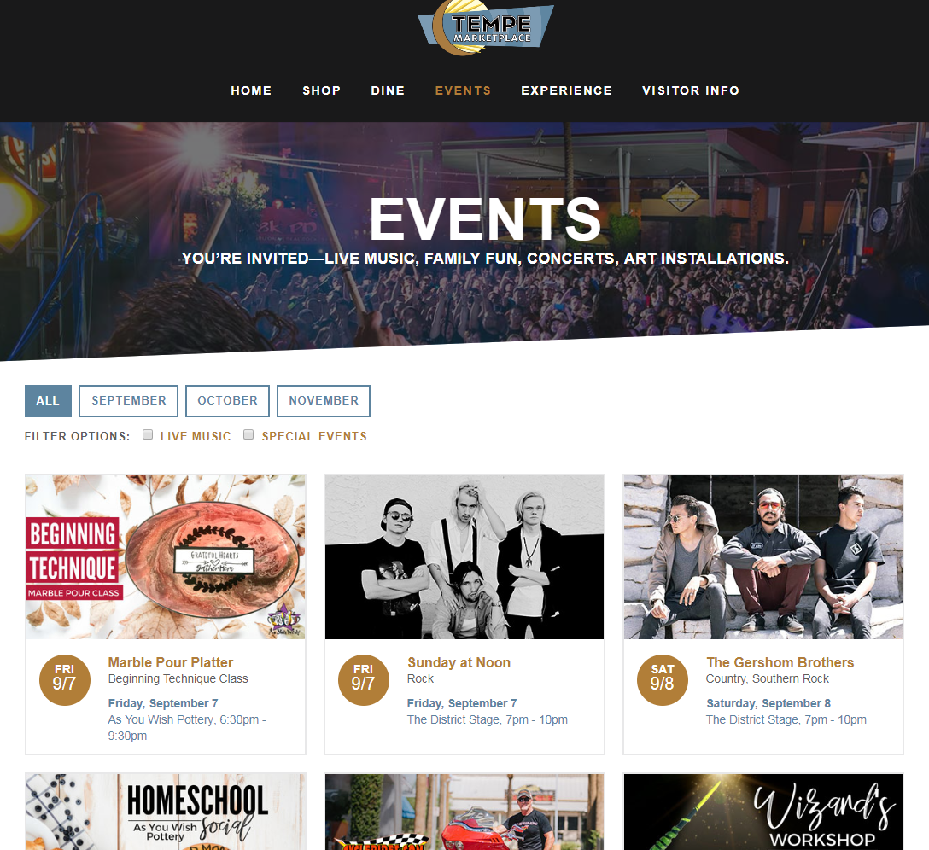
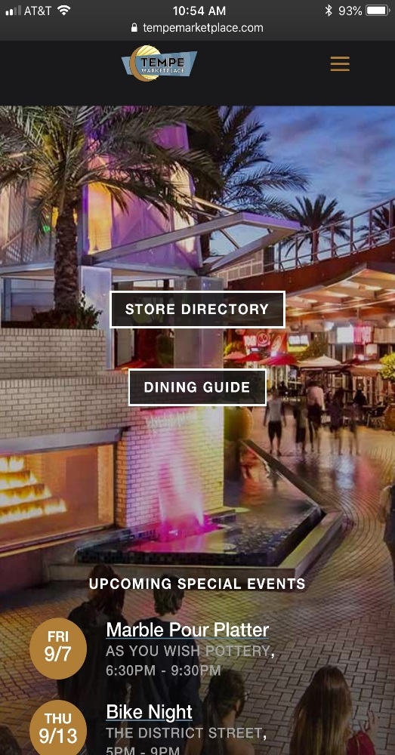
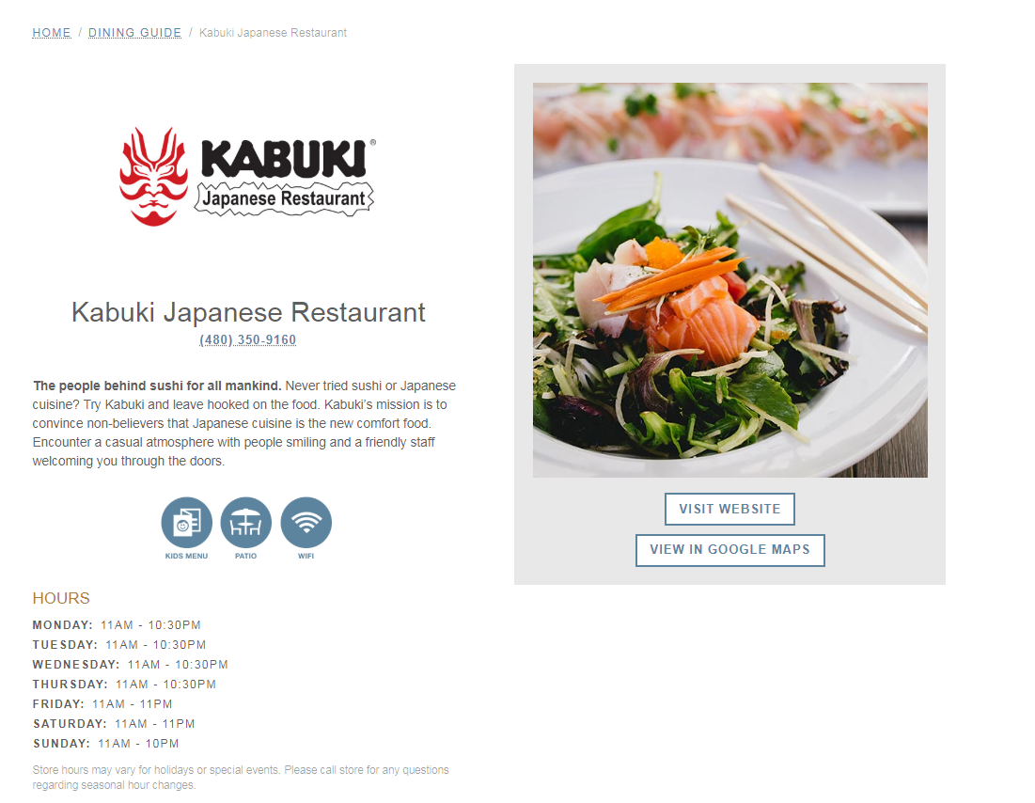
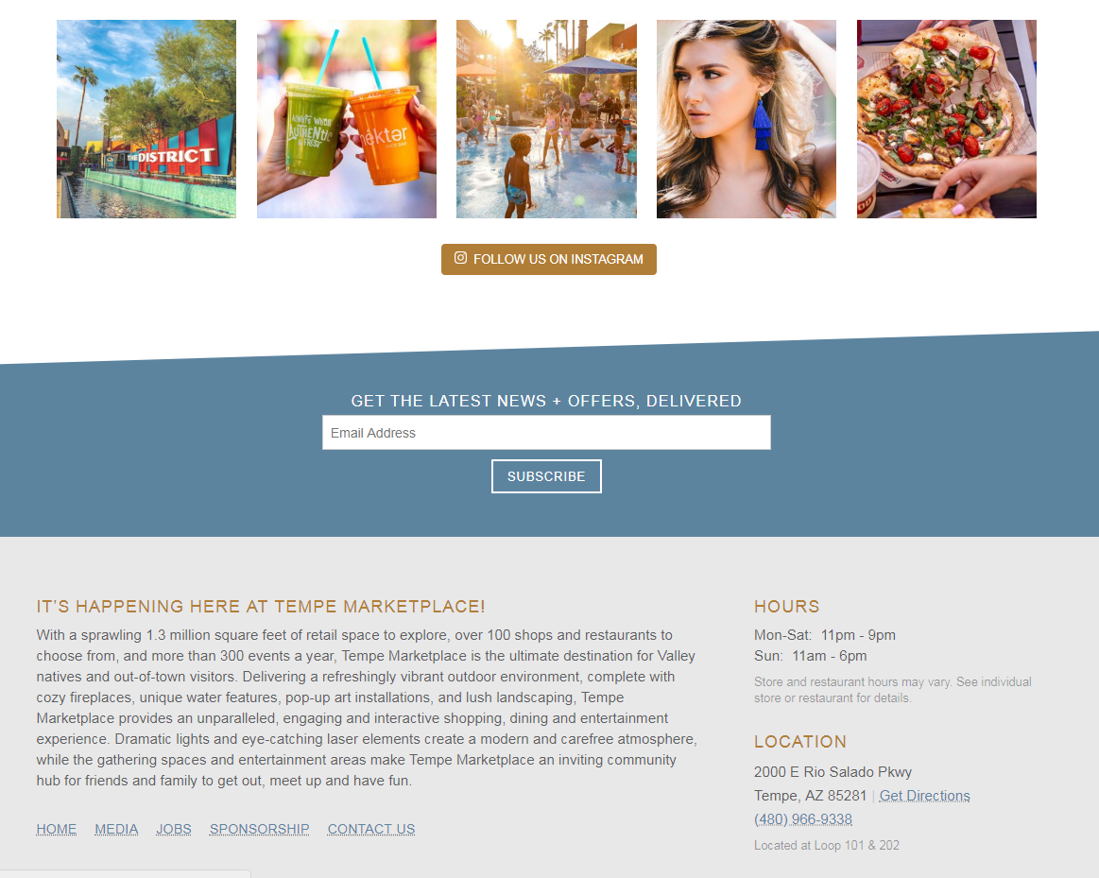
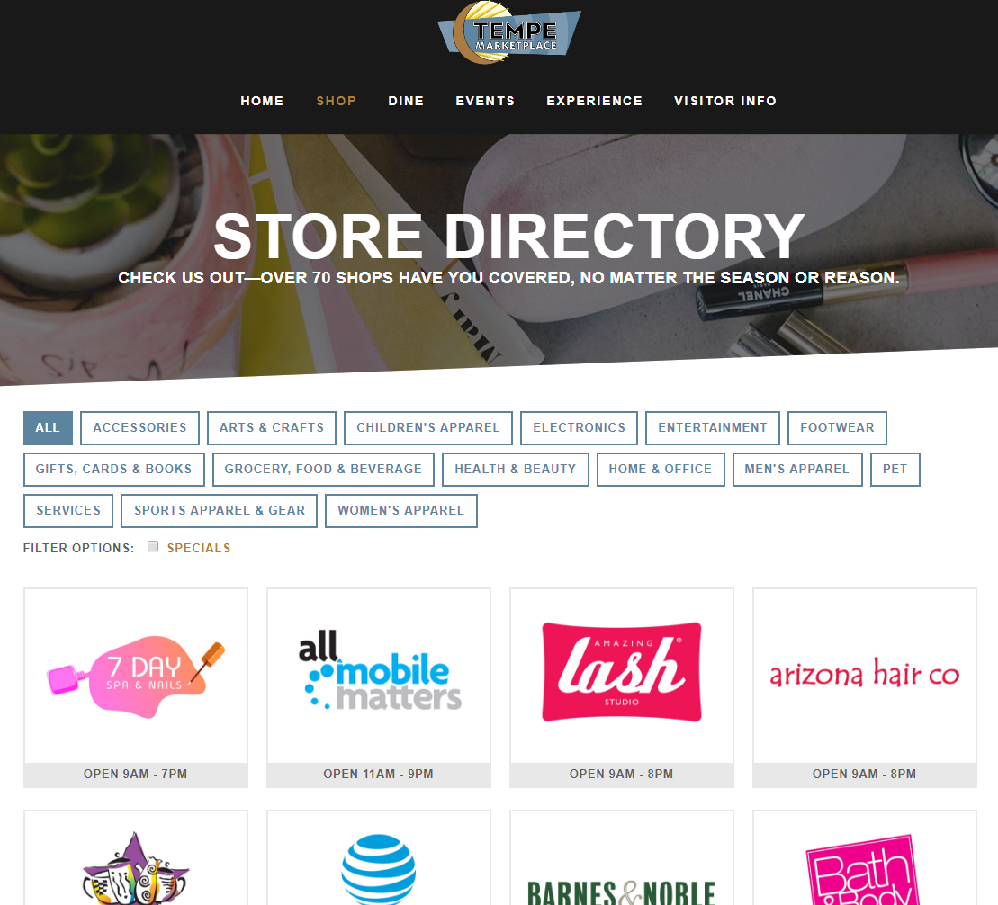
WEBSITE
  Sales + Promotions
  Happy Hour + Specials
  Jobs
  Events

Slide 9
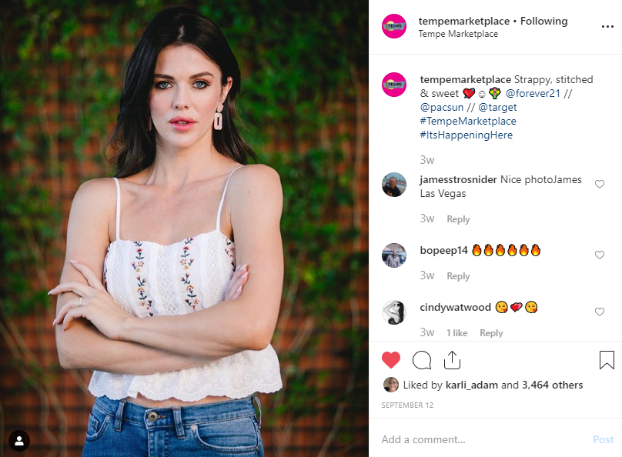
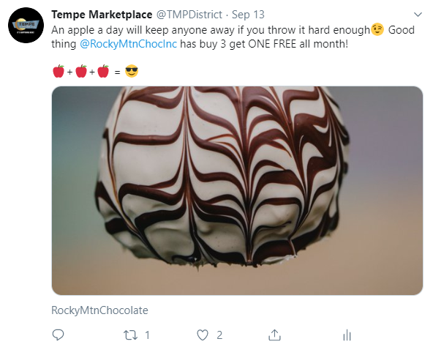
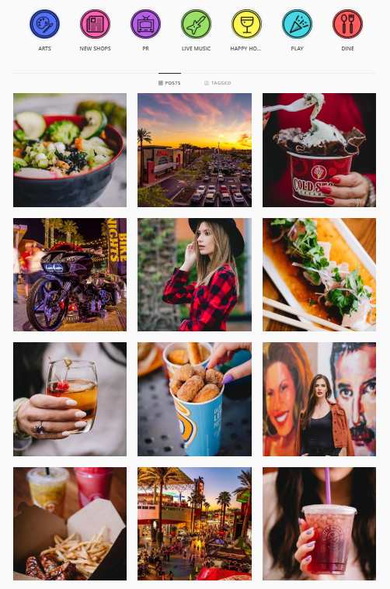
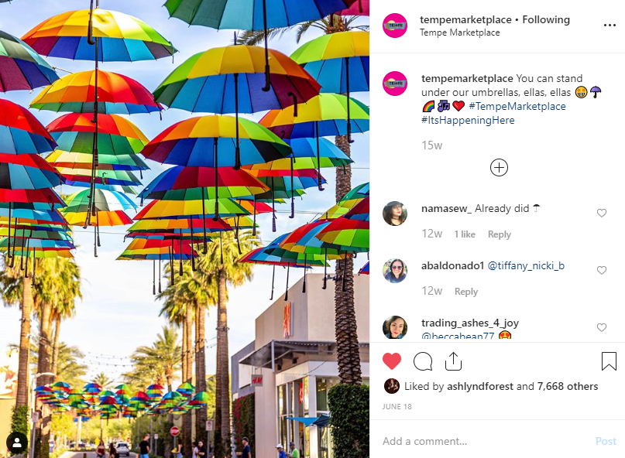
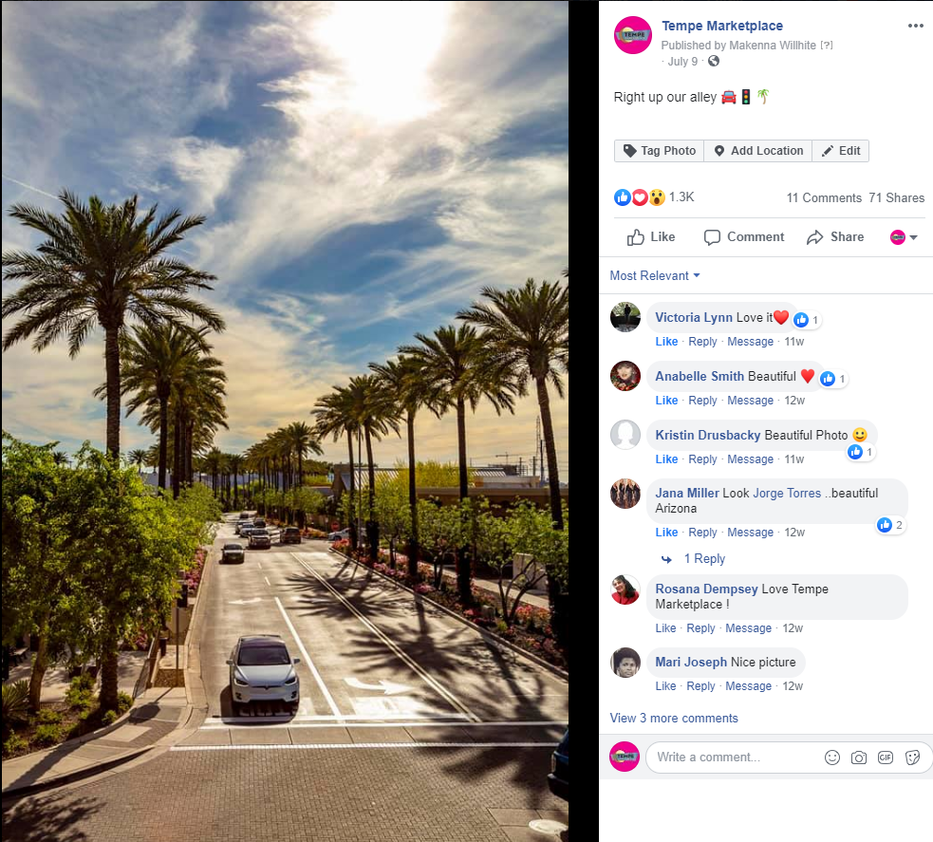
Social media
INSTAGRAM
  3,148,804 YTD impressions
  5,825 YTD increase in followers
FACEBOOK
  6,916,184 YTD impressions
  3,768 YTD increase in followers
TWITTER
  140,221 YTD impressions

Slide 10
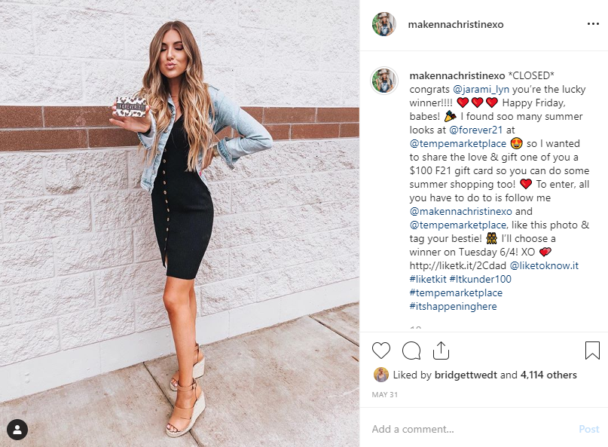
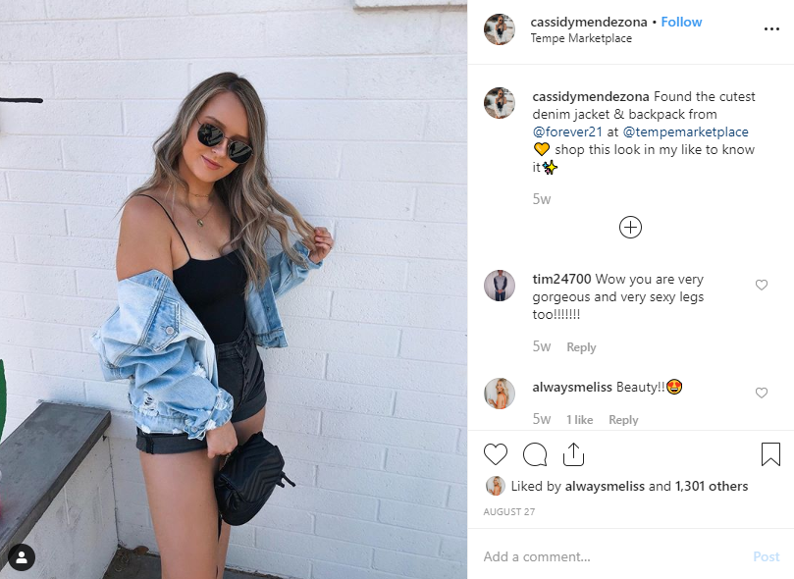
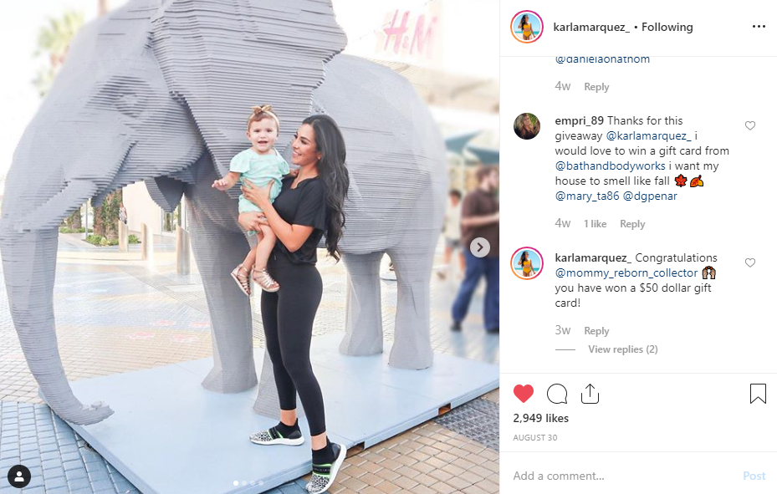
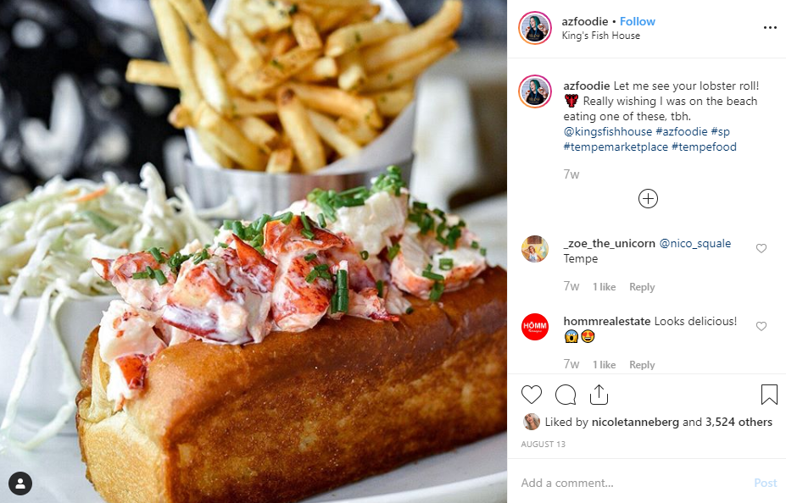
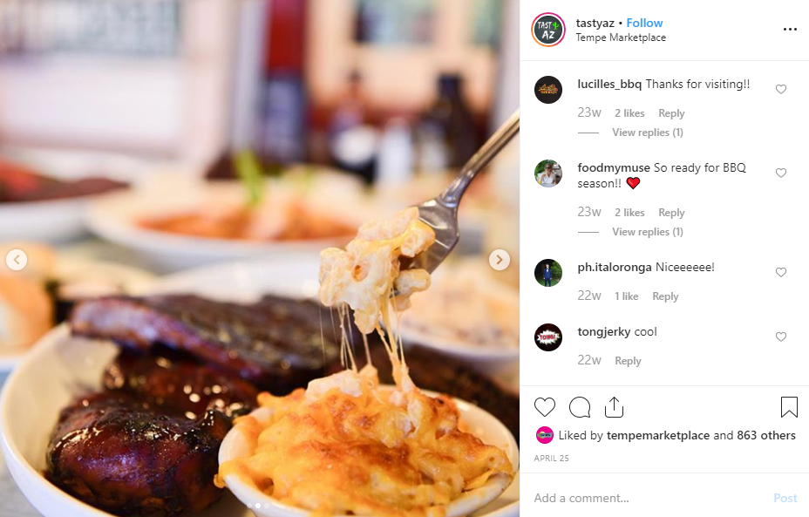
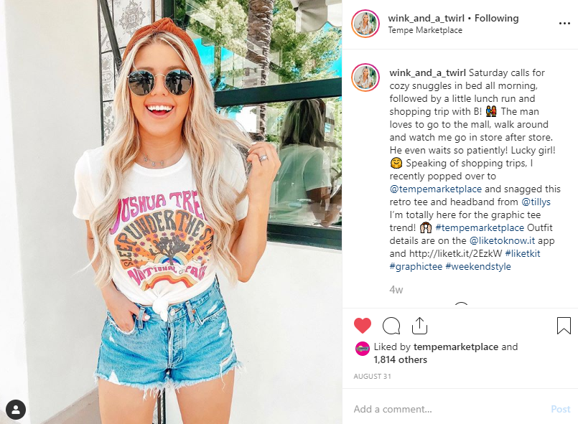
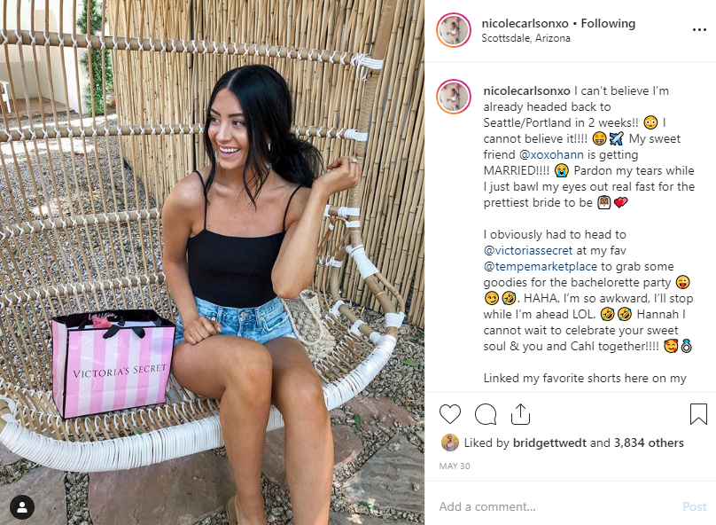
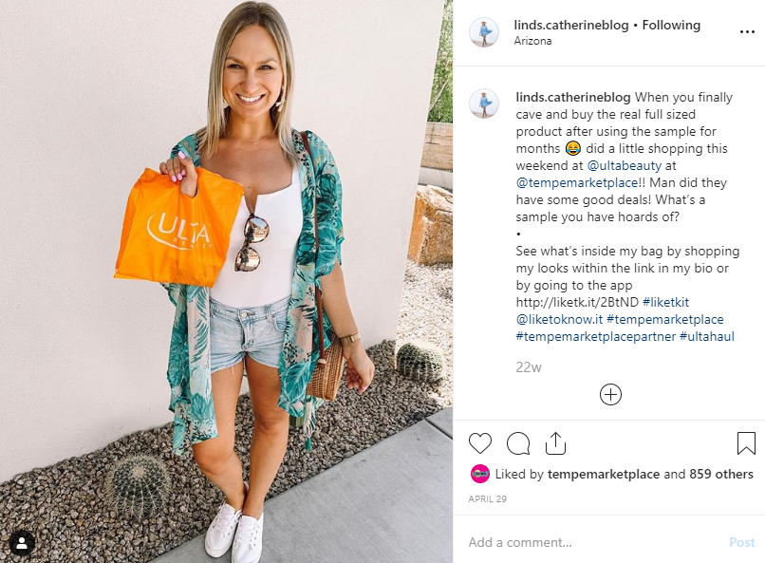
SOCIAL MEDIA INFLUENCERS
  Food Bloggers
    @tastyaz
    @azfoodie
  Fashion/Lifestyle Bloggers
    @karlamarquez_
    @makennachristinexo
    @nicolecarlsonxo
    @wink_and_a_twirl
    @linds.catherineblog
    @cassidymendezona
YTD Total Impressions: 2,212,036
Total Combined Following: 498,400 followers

Slide 11
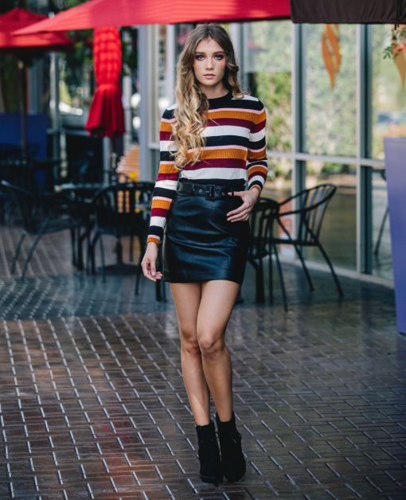
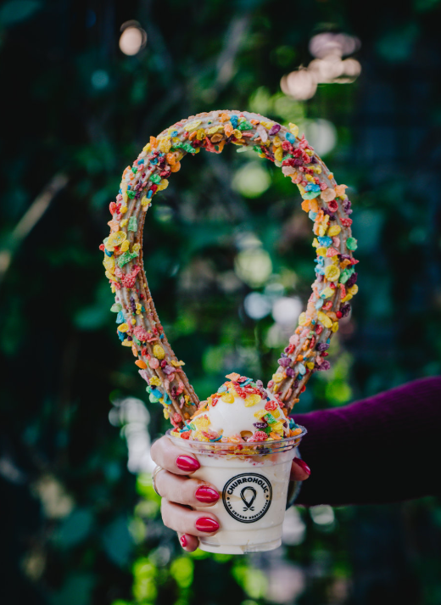
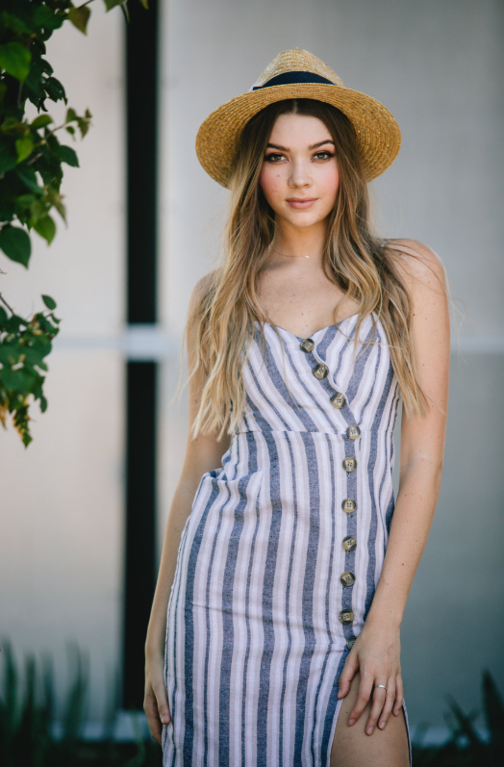
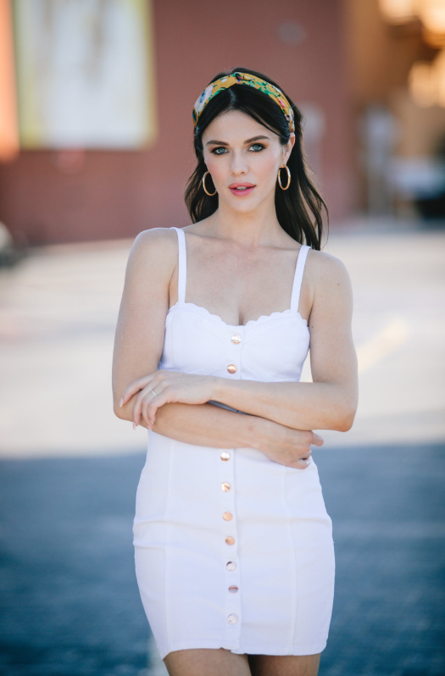





Quarterly photoshoots
Highlighting tenants and showcasing center features
Used for social media and advertising

Slide 12





Marketing partnerships
GIFT-WITH-PURCHASE
  484 redemptions YTD
  $164,077 in trackable sales YTD
  Partnerships include: WM Phoenix Open, Renaissance Festival, Oakland A’s, Phoenix Zoo, Butterfly Wonderland, The Arizona Ballet Co. and others
ENTER-TO-WIN
  10,403 total entries YTD
  Partners include: Live Nation, ASU Gammage, University of Phoenix Stadium and others

Slide 13




FREE 2019 opportunities
ASU Discounts
Lunch VIP Card
Valentine’s Day Basket
Spring Training Show Your Stub Savings
St. Patrick’s Day Basket
Seasonal Specials
  Mother’s Day
  Father’s Day
  Back-to-School
  Holiday

Slide 14




LRA + ADVERTISING
Digital Billboard Ad
Digital Display Ads
Overhead MOOD Messages
LED Video Wall Ad
Custom Dedicated Email Blast
Web Banner
22x28 Signage
30x70 Signage

Slide 15




monthly newsletters

Slide 16





Public relations
2019 YTD HIGHLIGHTS
  185,586,837 impressions
  $1,036,738.19 value
2018 TOTALS
  276,295,490 impressions
  $6,487,813.04 value

Slide 17

WIFI & TRAFFIC DATA
  Traffic Counter Numbers
    2019 YTD – 5,938,586 cars; 13,658,748 visitors
    2018 – 7,465,157 cars; 17,169,861 visitors
  Cisco Meraki WIFI
    Launched in The District end of July
    Average Daily Figures:
      Passerby: 56,006
      Visitors: 4,174
      Connected: 442

Slide 18



2019 PLACER.AI Mobile Data
  2.8M Customers YTD, with 9.9M Visits
  Median trade area household income is $48,504
  Core market extends from Scottsdale to Central Phoenix to Chandler, with a trade area of 695,178 residents
  Age Breakdown:
    < 18: 22.4%
    18-24: 14.3%
    25-34: 19%
    35-44: 12.9%
    45-54: 11.7%
    55-64: 9.7%
    65+: 10%
  49% Female; 51% Male
  57.1% Family Households; 42.9% Non-Family Households
  Weekends are busiest, 6pm-8pm peak hours
  Average stay 90 minutes
  Other Frequently Visited Spots:
    Sky Harbor
    Mesa Riverview
    ASU
    Scottsdale Fashion Square
    Chandler Fashion Center

Slide 19



Security UPDATES
  One Call Reminder
  Safety Reminders
  PD Tips
    Officer Megan Erwin, CSAS, CCPS
TMP DISPATCH
(480) 968-0004
AVAILABLE 24/7

Slide 20

QUESTIONS?

Slide 21

THANK YOU!

